Slide 1
Module 5
Cloud Delivery Model Considerations

Slide 2
Contents
The cloud provider perspective
Building IaaS environments,
Equipping PaaS environments
Optimizing SaaS environments
The cloud consumer perspective.
Working with IaaS environments.
Working with PaaS environments.
Working with SaaS services.

Slide 3
The cloud delivery model such as IaaS, PaaS, SaaS issues related to
The cloud provider perceptive
The cloud consumer perceptive.

Slide 4
The cloud provider perceptive
The integration and management of cloud based environments and how these are related to other technologies are examined.
Building IaaS Environment
The virtual server and cloud storage device mechanisms are the most fundamental IT resources that are part of provisioning architecture within IaaS environments.
They are offered various standardized configurations that are determined by the following properties.
operating system
primary memory capacity
processing capacity
virtualized storage capacity.

Slide 5
Memory and virtual storage capacity is allocated with increments of 1GB .
When limited cloud consumer access to virtualised environment , IaaS offers by cloud providers via virtual server images that capture the predefined configurations.
Some cloud providers provides cloud consumers to direct access to physical IT resources in such case bare-metal architecture(guest OS runs on the top of the hypervisor that runs directly on the host hardware) is used.
Snapshots can be taken of a virtual server to record the current state, memory and configuration of virtualized IaaS environment for backup and replication in support of horizontal and vertical scaling.

Slide 6
Data Centre
Cloud providers can offer IaaS-based IT resources from multiple geographically diverse data centers. which provides the following primary benefits:
Multiple data centers can be linked together for increased resiliency. Each data center is located in different regions there is a lower chance of a single failure of all data centers to go offline simultaneously.
Connected through high-speed communications networks with low latency, data centers can perform load balancing, IT resource backup and replication, and increase storage capacity, while improving availability and reliability. Having multiple data centers spread over a greater area further reduces network latency.
Data centers that are deployed in different countries make access to IT resources more convenient for cloud consumers that are limited by legal and regulatory requirements.

Slide 7
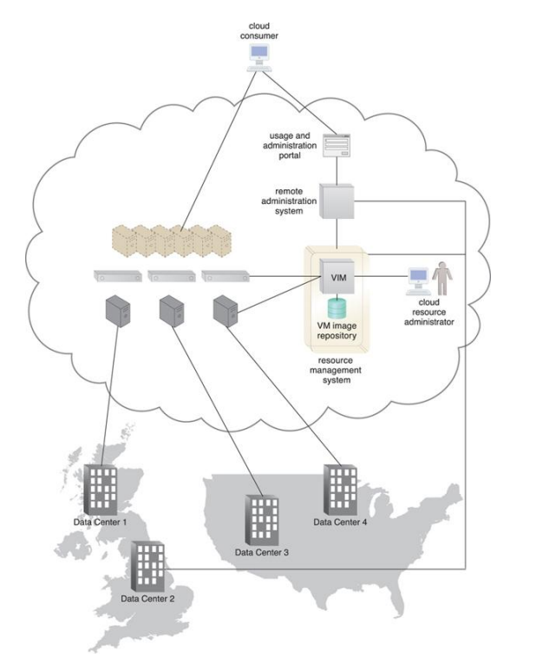
A cloud provider is provisioning and managing an IaaS environment with IT resources from different data centers in the United States and the United Kingdom.
When an IaaS environment is used to provide cloud consumers with virtualized network environments, each cloud consumer is segregated into a tenant environment that isolates IT resources from the rest of the cloud through the Internet. VLANs and network access control software collaboratively realize the corresponding logical network perimeters.

Slide 8
Scalability and Reliability
Within IaaS environments, cloud providers can automatically provision virtual servers via the dynamic vertical scaling type of dynamic scalability architecture.
This can be performed through VIM, VIM can scale virtual servers using resource replication as a type of resource pooling architecture.
The load balancing mechanism as a type of work distribution architecture can be used to distribute the workload among IT resources in a pool to complete the horizontal scaling process.
Manual scalability requires the cloud consumer to interact with a usage and administration program to explicitly request it resource scaling.
In dynamic scaling, it uses automatic scaling listener to monitor the workload and performs automatic scaling.

Slide 9
Replicated IT resources can be arranged in high availability configuration that reduces failover system via VIM.
The multipath resource access architecture improves reliability via a use of redundant access paths.
Resource reservation architecture also used by some cloud providers they provision dedicated IT resources.

Slide 10
Monitoring
Cloud usage monitors in an IaaS environment can be implemented by using specialized monitoring tools that directly interface with the virtualization platform.
Some common capabilities of the IaaS platform involve monitoring:
Virtual server lifecycles: Recording and tracking update periods and allocation of IT resources for pay-per-use monitors and time base billing purpose.
Data Storage: Tracking and assigning the allocation of storage capacity to cloud storage devices on virtual servers for pay-per-use monitors for billing purposes.
Network traffic: For pay-per-use monitors that measure inbound and outbound network usage and SLA monitors that track QoS metrics such as response times and network losses.

Slide 11
Failure conditions: For SLA monitors that track IT resource and QoS metrics to provide warning in times of failure.
Event triggers: For audit monitors that evaluate the regulatory compliance of selected IT resources.
Security
Cloud security mechanisms that are relevant for securing IaaS environment include:
Encryption, hashing, digital signature and PKI mechanisms for overall protection of data transmission.
IAM and SSO mechanisms for accessing services and interfaces in security systems based on user identification, authentication and authorization capabilities.
Cloud based security groups for isolating virtual environments through hypervisors and network segments via network management software.
Various cloud usage monitors to track provisioned virtual IT resources to detect abnormal usage patterns.

Slide 12
Equipping PaaS Environments
PaaS environment need a selection of application development and deployment platform in order to accommodate different programming models, languages and frameworks.
A separate environment is created for each programming stack that contains the necessary software to run the applications.
Each platform is accompanied by matching SDK, IDE which can be custom built enabled by IDE plugins supplied by cloud provider.
All the security related mechanism are simulated in that development environments.
Cloud providers provide resource management system mechanism that is customized for the PaaS platform so that consumers can create and control customized read-made environment by using virtual server images.
Rapid provisioning architecture knows as platform provisioning which is used to create ready-made environments.

Slide 13
Scalability and Reliability
The scalability requirements of cloud services and applications that are deployed in PaaS are addressed via dynamic scalability and workload distribution architectures which uses native automated scaling listeners and load balancers.
The resource pooling architecture used to provision IT resources form resource pools made available to multiple cloud consumers.
Cloud providers can evaluate network traffic and server-side connection usage against the instance’s workload, when determining how to scale an overloaded application as per parameters and cost limitations provided by cloud consumer.
Cloud consumers can configure the application designs to customize by using available mechanisms themselves.

Slide 14
The reliability of ready-made environments and hosted cloud services and applications can be supported with standard failover systems.
The resource reservation architecture may also be in place to offer exclusive access to PaaS-based IT resources.
With other IT resources ready-made environments can also span multiple data centers and geographical regions to further increase availability and resiliency.

Slide 15
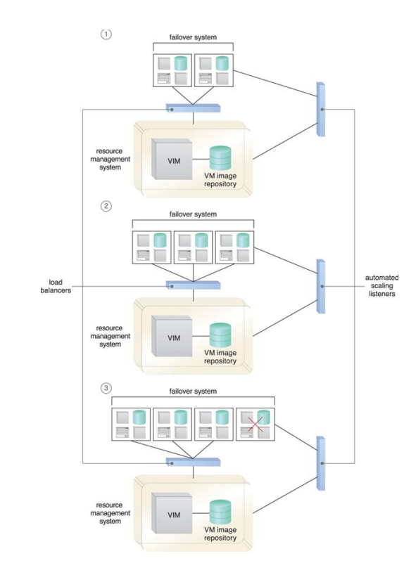
Load balancers are used to distribute ready-made environment instances that are part of a failover system, while automated scaling listeners are used to monitor the network and instance workloads (1). The ready-made environments are scaled out in response to an increase in workload (2), and the failover system detects a failure condition and stops replicating a failed ready-made environment (3).

Slide 16
Monitoring
Specialized cloud usage monitors in PaaS environments are used to monitor the following:
Ready-made environment instances: The applications of these instances are recorded by pay-per-use monitors for the calculation of time based usage fees.
Data Persistence: This statistic is provided by pay-per-use monitors that record the number of objects, individual occupied storage sizes, and database transactions per billing period.
Network Usage: Inbound and outbound network usage is tracked for pay-per-use monitors and SLA monitors that track network-related QoS metrics.
Failure Conditions: SLA monitors that track the QoS metric of IT resources need to capture failure statistics.
Event triggers: This metric is used by audit monitors that need to respond to certain types of events.
Security
The PaaS environment does not usually introduce the need for new cloud security mechanisms because those are already provisioned for IaaS environments.

Slide 17
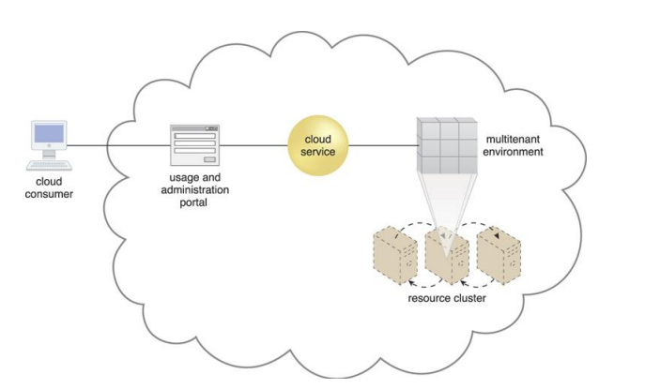
Optimizing SaaS Environment
In SaaS implementations, cloud service architectures are based on multitenant that enable concurrent cloud consumer access.
The SaaS-based cloud service is hosted by a multitenant environment deployed in a high-performance virtual server cluster. A usage and administration portal is used by the cloud consumer to access and configure the cloud service.

Slide 18
SaaS IT resource segregation does not typically occur at the infrastructure level in SaaS environments, as it does in IaaS and PaaS environments.
SaaS implementations are based on dynamic scalability architecture and workload distribution architecture as well as non-disruptive service relocation to ensure the failover condition do not impact the availability of SaaS based services.
Each SaaS deployment is unique architectural, functional and runtime requirements.
SaaS based cloud service is programmed with specific business logic and different usage patterns.

Slide 19
The following are the online SaaS offerings:
collaborative authoring and information-sharing (Wikipedia, Blogger)
collaborative management (Zimbra, Google Apps)
conferencing services for instant messaging, audio/video communications (Skype, Google Talk).
enterprise management systems (ERP, CRM, CM)
industry-specific software (engineering, bioinformatics)
messaging systems (e-mail, voicemail)
mobile application marketplaces (Android Play Store, Apple App Store)
office productivity software suites (Microsoft Office, Adobe Creative Cloud)
search engines (Google, Yahoo)
social networking media (Twitter, LinkedIn)

Slide 20
Those services are offered in one or more of the following implementation mediums:
Mobile application.
REST service.
Web service.
Each of these SaaS implementations medium provide Web-based APIs for interfacing by cloud consumers.
Ex: electronic payment services(PayPal).
mapping and routing services(Google Maps)
publishing tools(WordPress).
Mobile-enabled SaaS implementations are commonly supported by multi-device broker mechanism unless the cloud service is exclusively accessed by specific mobile devices.

Slide 21
Some architectural models used in SaaS environment are
Service Load Balancing – for workload distribution across redundant SaaS-based cloud service implementations .
Dynamic Failure Detection and Recovery – to establish a system that can automatically resolve some failure conditions without disruption in service to the SaaS implementation.
Storage Maintenance Window – to allow for planned maintenance outages that do not impact SaaS implementation availability .
Elastic Resource Capacity/Elastic Network Capacity – to establish inherent elasticity within the SaaS-based cloud service architecture that enables it to automatically accommodate a range of runtime scalability requirements.
Cloud Balancing – to impart broad resiliency within the SaaS implementation, which can be especially important for cloud services subjected to extreme concurrent usage volumes.

Slide 22
Monitors
Specialized cloud usage monitors can be used in SaaS environments to track the following types of metrics:
• Tenant Subscription Period – This metric is used by pay-per-use monitors to record and track application usage for time-based billing.
Application Usage – This metric, based on user or security groups, is used with pay-per-use monitors to record and track application usage for billing purposes.
Tenant Application Functional Module – This metric is used by pay-per-use monitors for function-based billing. Cloud services can have different functionality tiers according to whether the cloud consumer is free-tier or a paid subscriber.
Security
SaaS implementations generally depend on foundation of security controls inherent to their deployment environment.

Slide 23
Cloud Delivery Models: The Cloud Consumer Perspective
Working with IaaS Environment
Virtual servers are accessed at the operating system level through the use of remote terminal applications.
Accordingly, the type of client software used directly depends on the type of operating system that is running at the virtual server, of which two common options are:
• Remote Desktop (or Remote Desktop Connection) Client – for Windows-based environments and presents a Windows GUI desktop.
• SSH Client – for Mac and other Linux-based environments to allow for secure channel connections to text-based shell accounts running on the server OS .

Slide 24
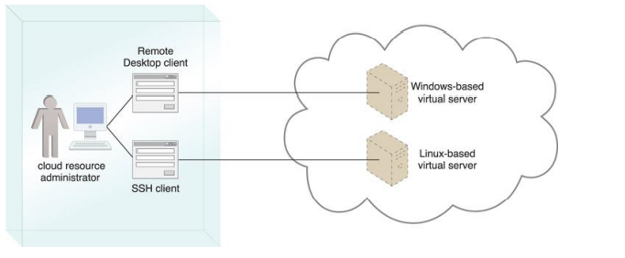
A cloud resource administrator uses the Windows-based Remote Desktop client to administer a Windows-based virtual server and the SSH client for the Linux-based virtual server.

Slide 25
There are two ways to connect with the cloud storage device.
1. A cloud storage device can be attached directly to the virtual servers and accessed through the virtual servers’ functional interface for management by the operating system.
2. Alternatively, a cloud storage device can be attached to an IT resource that is being hosted outside of the cloud, such as an on-premise device over a WAN or VPN. In this case the following formats for the manipulation and transmission of cloud storage data are
Network Filesystem – Files and folders are organized in NFS,CIFS system.
Storage area network devices – Block based storage access allows data to be placed in consistent files for optimal network transmission (iSCSI, Fiber channel) .
Web based resources -- Object-based storage access by which an interface that is not integrated into the operating system logically represents files, which can be accessed through a Web-based interface (Amazon S3).

Slide 26
IT Resource Provisioning Considerations
Cloud consumers have a high degree of control over how and to what extent IT resources are provisioned which includes
controlling scalability features (automated scaling, load balancing)
• controlling the lifecycle of virtual IT resources (shutting down, restarting, powering up of virtual devices)
• controlling the virtual network environment and network access rules (firewalls, logical network perimeters)
• establishing and displaying service provisioning agreements (account conditions, usage terms)
• managing the attachment of cloud storage devices
• managing the pre-allocation of cloud-based IT resources (resource reservation)
• managing credentials and passwords for cloud resource administrators

Slide 27
• managing credentials for cloud-based security groups that access virtualized IT resources through an IAM
• managing security-related configurations
• managing customized virtual server image storage (importing, exporting, backup)
• selecting high-availability options (failover, IT resource clustering)
• selecting and monitoring SLA metrics
• selecting basic software configurations (operating system, pre-installed software for new virtual servers)
• selecting IaaS resource instances from a number of available hardware related configurations and options (processing capabilities, RAM, storage)
• selecting the geographical regions in which cloud-based IT resources should be hosted
• tracking and managing costs

Slide 28
Working with PaaS Environments
A typical PaaS IDE can offer a wide range of tools and programming resources, such as software libraries, class libraries, frameworks, APIs, and various runtime capabilities that emulate the planned cloud-based deployment environment.
These features allow developers to create, test, and run application code within the cloud or locally (on-premise) while using the IDE to emulate the cloud deployment environment.
Compiled or completed applications are then bundled and uploaded to the cloud, and deployed via the ready-made environments.
PaaS also allows for applications to use cloud storage devices as independent data storing systems for holding development-specific data.
Both SQL and NoSQL database structures are generally supported.

Slide 29
IT Resource Provisioning Considerations
PaaS environments provide less administrative control than IaaS environments, but still offer a significant range of management features.
Establishing and displaying service provisioning agreements, such as account conditions and usage terms
selecting software platform and development frameworks for readymade environments
selecting instance types, which are most commonly frontend or backend instances
selecting cloud storage devices for use in ready-made environments
controlling the lifecycle of PaaS-developed applications (deployment, starting, shutdown, restarting, and release)

Slide 30
Controlling the versioning of deployed applications and modules
Configuring availability and reliability-related mechanisms
Managing credentials for developers and cloud resource administrators using IAM
Managing general security settings, such as accessible network ports
selecting and monitoring PaaS-related SLA metrics
managing and monitoring usage and IT resource costs
controlling scalability features such as usage quotas, active instance thresholds, and the configuration and deployment of the automated scaling listener and load balancer mechanisms.

Slide 31
Working with SaaS Services
SaaS-based cloud services are almost always accompanied by refined and generic APIs, they are usually designed to be incorporated as part of larger distributed solutions.
Example: Google Maps offers API that enables mapping information and images to be incorporated into Websites and web based applications.
Many SaaS offerings are provided free of charge, although these cloud services often come with data collecting sub-programs that produce usage data for the benefit of the cloud provider.
When using any SaaS product that is sponsored by third parties, there is a reasonable chance that it is performing a form of background information gathering.

Slide 32
Cloud consumers using SaaS products supplied by cloud providers are relieved of the responsibilities of implementing and administering their underlying hosting environments.
Customization options are usually available to cloud consumers; however, these options are generally limited to the runtime usage control of the cloud service instances that are generated specifically by and for the cloud consumer which include
managing security-related configurations
managing select availability and reliability options
managing usage costs.
managing user accounts, profiles, and access authorization
selecting and monitoring SLAs
setting manual and automated scalability options and limitations

Slide 33
Case Study Example
DTGOV discovers that a number of additional mechanisms and technologies need to be assembled in order to complete its IaaS management architecture
Network virtualization is incorporated into logical network topologies, and logical network perimeters are established using different firewalls and virtual networks.
The VIM is positioned as the central tool for controlling the IaaS platform and equipping it with self-provisioning capabilities.
Additional virtual server and cloud storage device mechanisms are implemented through the virtualization platform, while several virtual server images that provide base template configurations for virtual servers are created.

Slide 34
Dynamic scaling is added using the VIM’s API through the use of automated scaling listeners.
High-availability virtual server clusters are created using the resource replication, load balancer, failover system, and resource cluster mechanisms.
A customized application that directly uses the SSO and IAM system mechanisms is built to enable interoperability between the remote administration system, network management tools, and VIM.
DTGOV uses a powerful commercial network management tool that is customized to store event information gathered by the VIM and SLA monitoring agents in an SLA measurements database.
DTGOV expands a proprietary software tool that is based on a set of usage measurements from a database populated by pay-per-use monitors.
The billing software is used as the base implementation for the billing management system mechanism

Slide 35
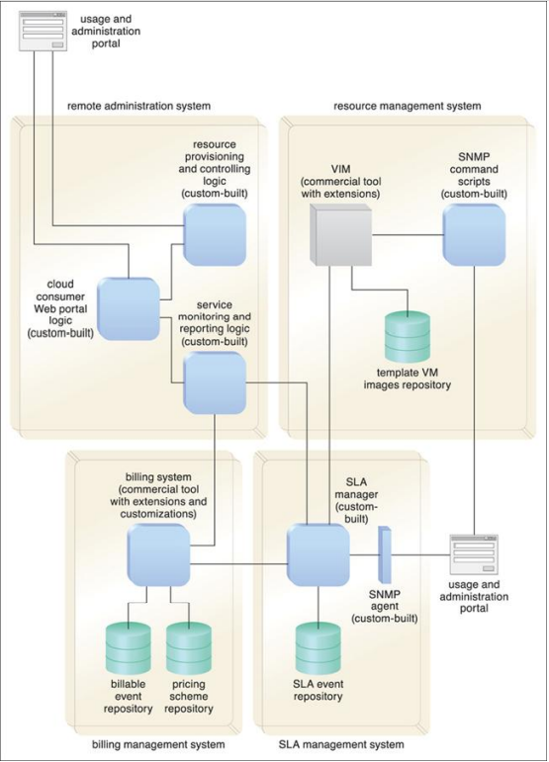
An overview of the DTGOV management architecture

